Slide 1
Database Design with Entity-Relationship and Logical Models
KOWSHAL SUGUNARAJAH
101018751

Slide 2
Library Management System – Business Definition Table
Entity | Definition | Relationships
Member | A person who can borrow books and magazines. | Has multiple Memberships Can make multiple Reservations Can Checkout up to 5 items
Membership | Represents the type of membership (Adult, Child, etc.). | Belongs to one Member
Book | A borrowable item, written by authors and classified by genre. | Written by multiple Authors Belongs to one Genre Can be Reserved and Checked out by Members
Magazine | Periodical borrowable item. | Can be Checked out by Members
Genre | Category of a book (e.g., Fiction, Science). | Has multiple Books
Author | A person who writes books. | Writes multiple Books
Reservation | Record of a member reserving a book. | Links one Member to one Book (Many-to-many between Member and Book)
Checkout | Record of borrowing activity. | Links one Member with one Item (Book or Magazine) (Many-to-many with quantity limit constraint)

Slide 3
RELATIONSHIPS
Library Management System
Key Concepts to Include:
Entities: Book, Author, Genre, Member, Membership, Reservation, Checkout
Relationships:
Book–Author (many-to-many)
Book–Genre (many-to-one or one-to-many)
Member–Membership (one-to-many)
Member–Checkout (max 5)
Member–Reservation (one-to-many)

Slide 4
ENTITY AND ATTRIBUTES
Library Management System
Entity | Attributes
Member | member_id (PK), first_name, last_name, email, phone, address
Membership | membership_id (PK), member_id (FK), membership_type, start_date, end_date
Book | book_id (PK), title, publication_year, genre_id (FK)
Magazine | magazine_id (PK), title, issue_number, publication_date
Genre | genre_id (PK), genre_name
Author | author_id (PK), first_name, last_name
Book_Author | book_id (FK), author_id (FK)
Reservation | reservation_id (PK), member_id (FK), book_id (FK), reservation_date
Checkout | checkout_id (PK), member_id (FK), item_type, item_id, checkout_date, due_date, return_date

Slide 5
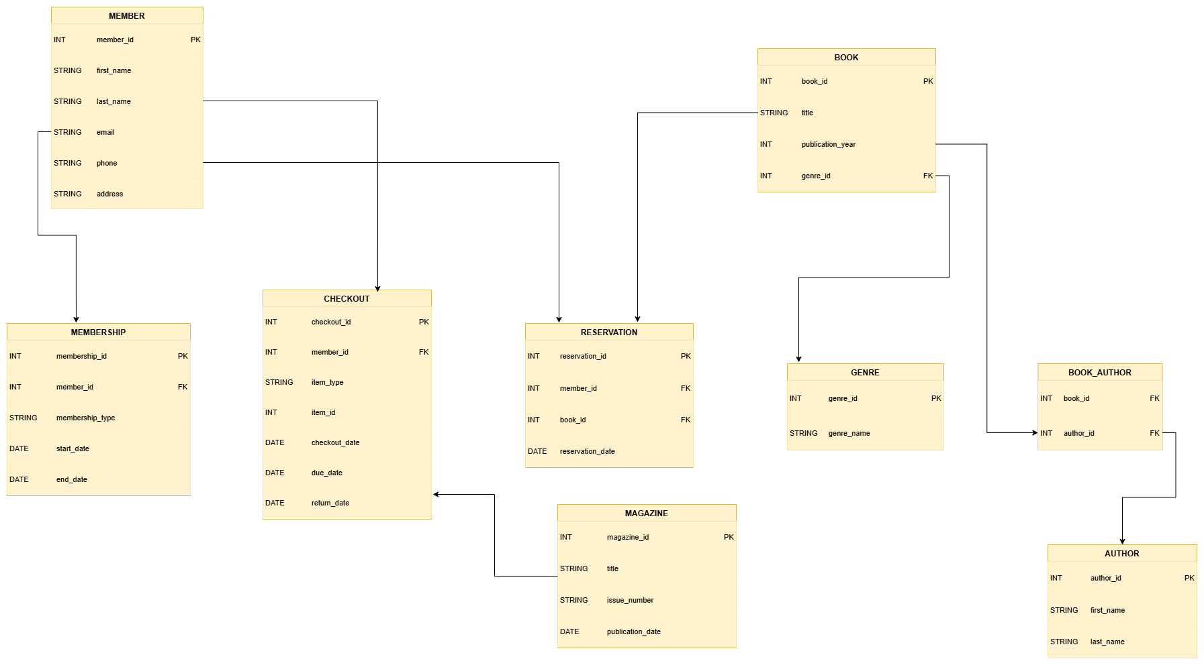
Logical model
Library Management System

Slide 6
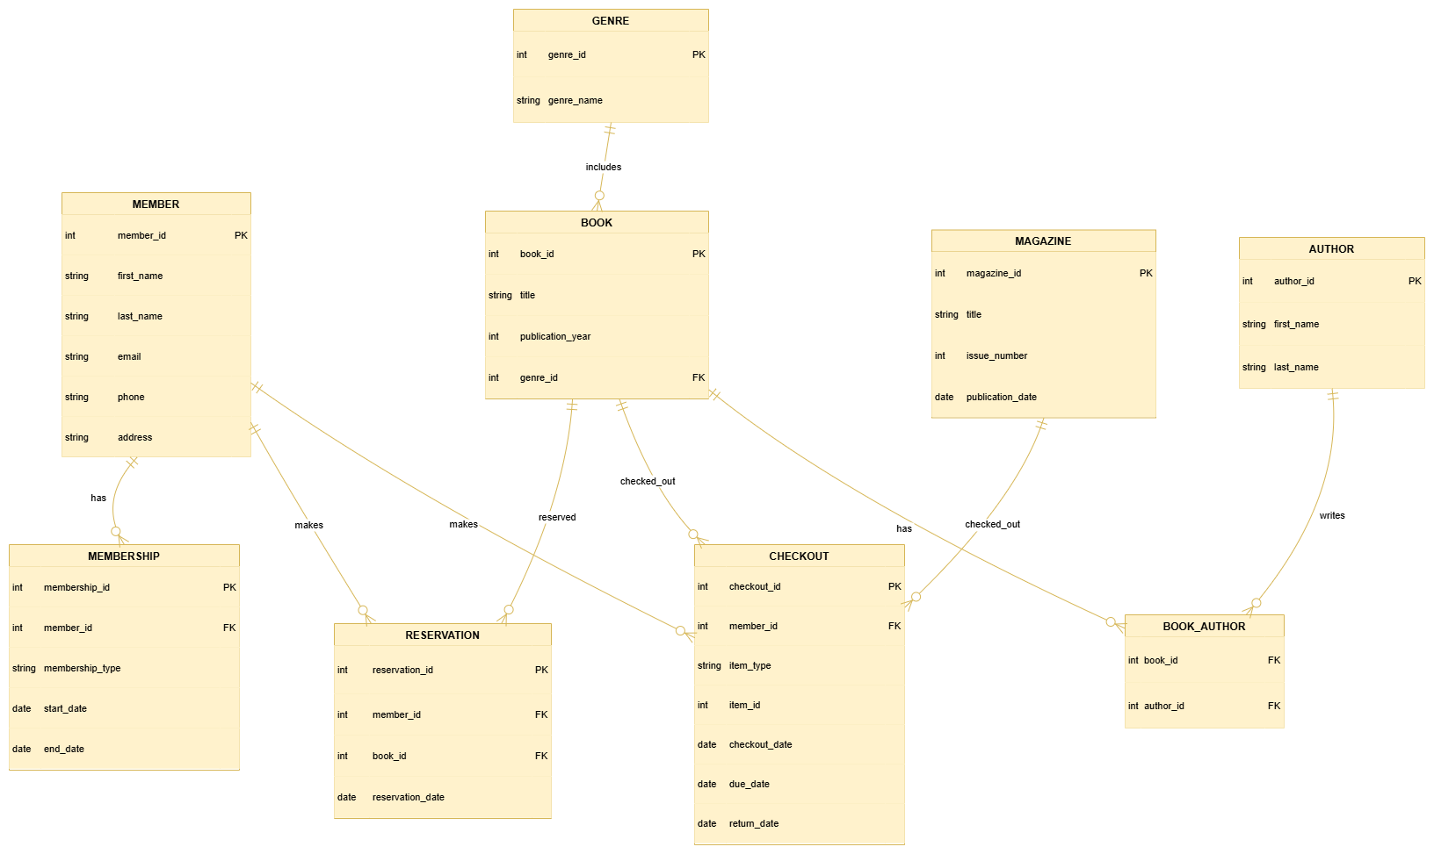
Entity-Relationship Model
Library Management System

Slide 7
PHYSICAL DESIGN
CREATING TABLES QUERIES
CREATE TABLE GENRE ( genre_id INT PRIMARY KEY, genre_name TEXT ); | CREATE TABLE AUTHOR ( author_id INT PRIMARY KEY, first_name TEXT, last_name TEXT ); | CREATE TABLE MEMBER ( member_id INT PRIMARY KEY, first_name TEXT, last_name TEXT, email TEXT, phone TEXT, address TEXT );
CREATE TABLE BOOK ( book_id INT PRIMARY KEY, title TEXT, publication_year INT, genre_id INT, FOREIGN KEY (genre_id) REFERENCES GENRE(genre_id) ); | CREATE TABLE MAGAZINE ( magazine_id INT PRIMARY KEY, title TEXT, issue_number TEXT, publication_date DATE ); | CREATE TABLE MEMBERSHIP ( membership_id INT PRIMARY KEY, member_id INT, membership_type TEXT, start_date DATE, end_date DATE, FOREIGN KEY (member_id) REFERENCES MEMBER(member_id) );
CREATE TABLE BOOK_AUTHOR ( book_id INT, author_id INT, PRIMARY KEY (book_id, author_id), FOREIGN KEY (book_id) REFERENCES BOOK(book_id), FOREIGN KEY (author_id) REFERENCES AUTHOR(author_id) ); | CREATE TABLE RESERVATION ( reservation_id INT PRIMARY KEY, member_id INT, book_id INT, reservation_date DATE, FOREIGN KEY (member_id) REFERENCES MEMBER(member_id), FOREIGN KEY (book_id) REFERENCES BOOK(book_id) ); | CREATE TABLE CHECKOUT ( checkout_id INT PRIMARY KEY, member_id INT, item_type TEXT CHECK (item_type IN ('BOOK', 'MAGAZINE')), item type INT, checkout_date DATE, due_date DATE, return_date DATE, FOREIGN KEY (member_id) REFERENCES MEMBER(member_id) );

Slide 8
PHYSICAL DESIGN
INSERTING DATA QUERIES
INSERT INTO MEMBER (member_id, first_name, last_name, email, phone, address) VALUES (1, 'Alice', 'Smith', 'alice@example.com', '1234567890', '123 Maple St'), (2, 'Bob', 'Johnson', 'bob@example.com', '2345678901', '456 Oak Ave'); | INSERT INTO MEMBERSHIP (membership_id, member_id, membership_type, start_date, end_date) VALUES (101, 1, 'Adult', '2025-01-01', '2025-12-31'), (102, 2, 'Child', '2025-03-01', '2026-02-28'); | INSERT INTO GENRE (genre_id, genre_name) VALUES (1, 'Fiction'), (2, 'Science'), (3, 'History');
INSERT INTO BOOK (book_id, title, publication_year, genre_id) VALUES (1001, 'The Time Machine', 1895, 2), (1002, 'The Great Gatsby', 1925, 1), (1003, 'A Brief History of Time', 1988, 2); | INSERT INTO MAGAZINE (magazine_id, title, issue_number, publication_date) VALUES (201, 'Tech Weekly', 'TW-301', '2025-06-01'), (202, 'Science Today', 'ST-192', '2025-05-20'); | INSERT INTO AUTHOR (author_id, first_name, last_name) VALUES (301, 'H.G.', 'Wells'), (302, 'F. Scott', 'Fitzgerald'), (303, 'Stephen', 'Hawking');
INSERT INTO BOOK_AUTHOR (book_id, author_id) VALUES (1001, 301), (1002, 302), (1003, 303); | INSERT INTO RESERVATION (reservation_id, member_id, book_id, reservation_date) VALUES (401, 1, 1001, '2025-06-10'), (402, 2, 1003, '2025-06-12'); | INSERT INTO CHECKOUT (checkout_id, member_id, item_type, item_id, checkout_date, due_date, return_date) VALUES (501, 1, 'BOOK', 1002, '2025-06-01', '2025-06-15', NULL), (502, 2, 'MAGAZINE', 201, '2025-06-05', '2025-06-20', '2025-06-18');

Slide 9
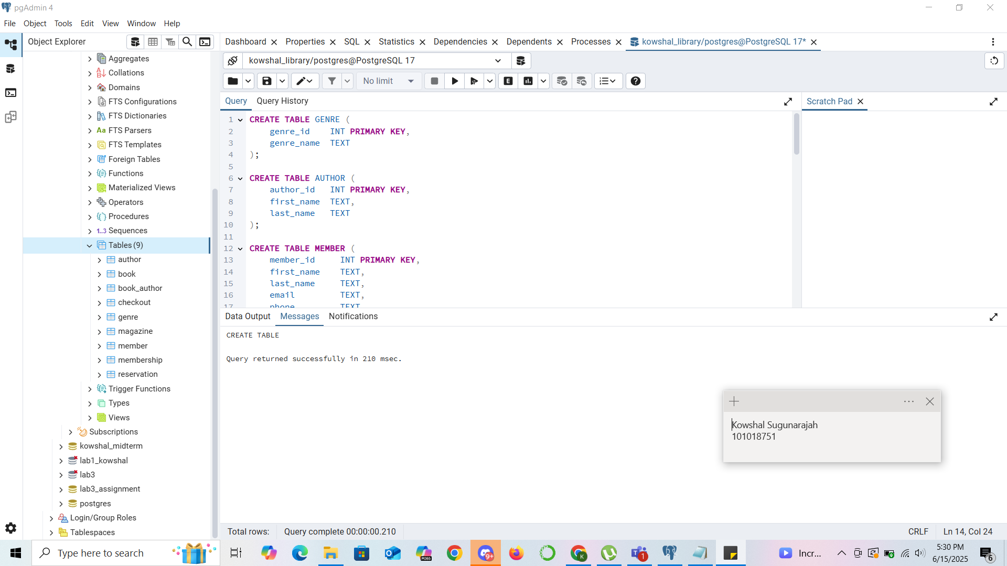
QUERY EXECUTION FOR TABLES

Slide 10
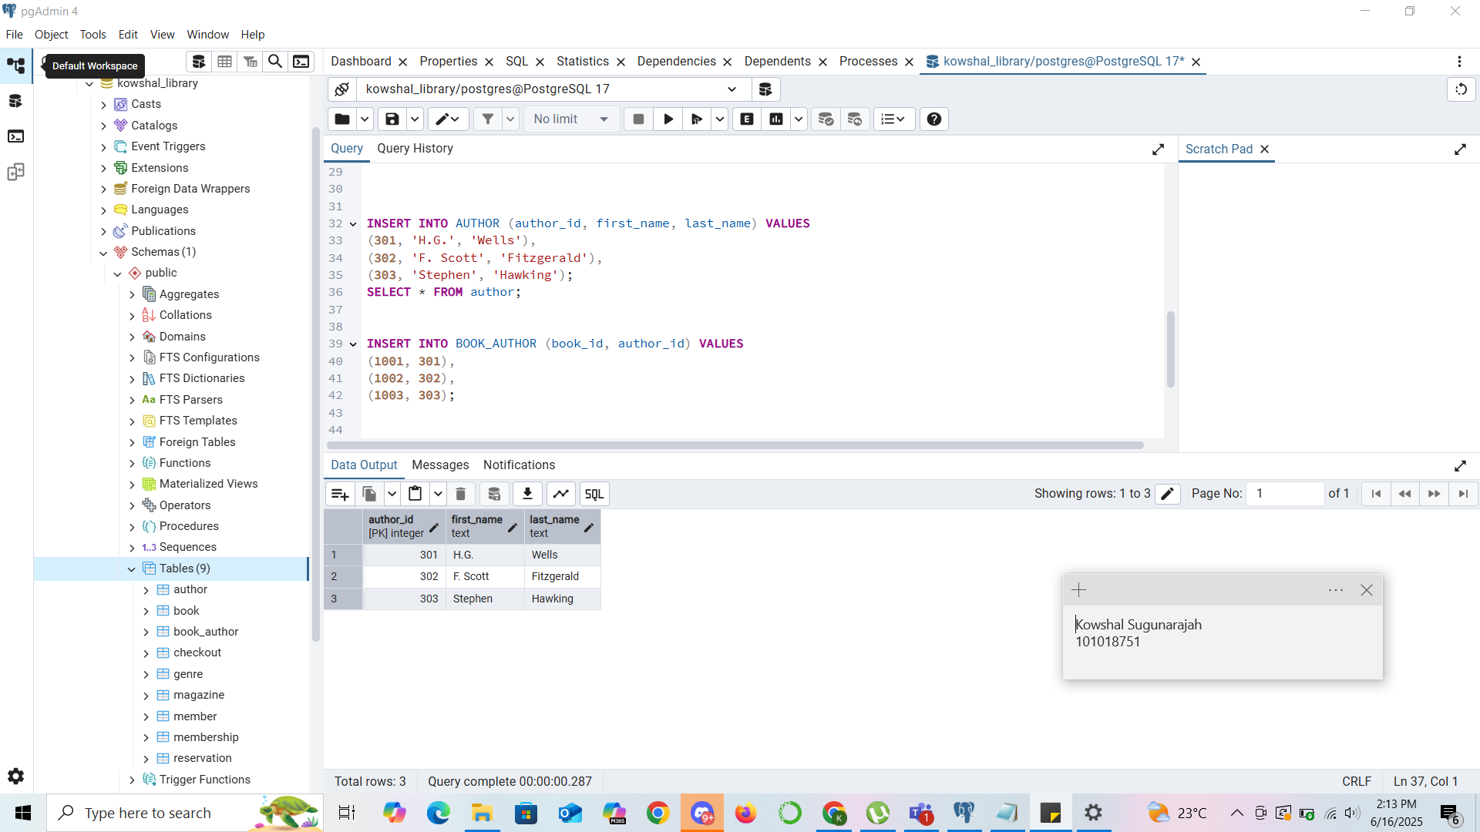
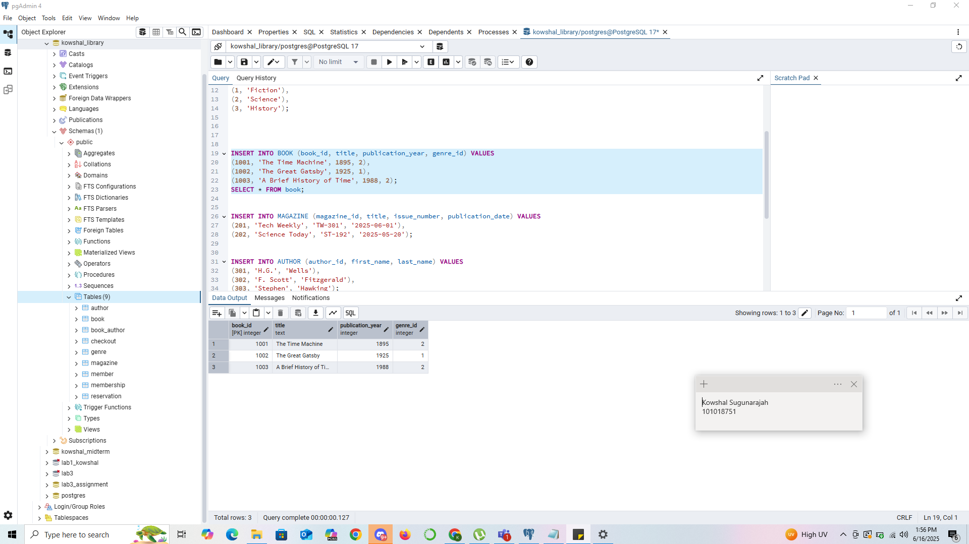
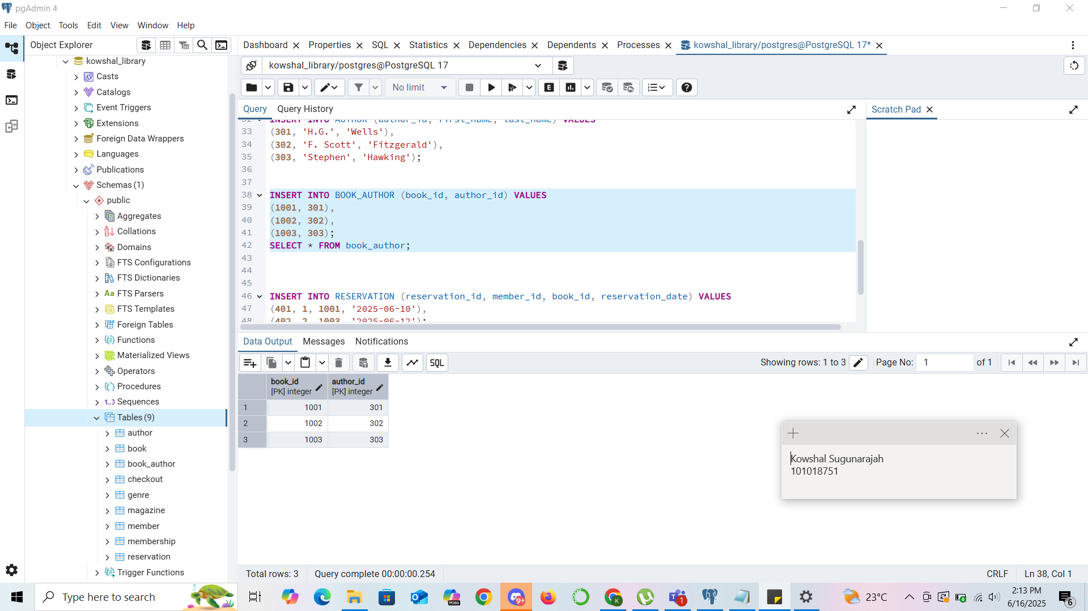
QUERY EXECUTION FOR INSERTING DATA

Slide 11
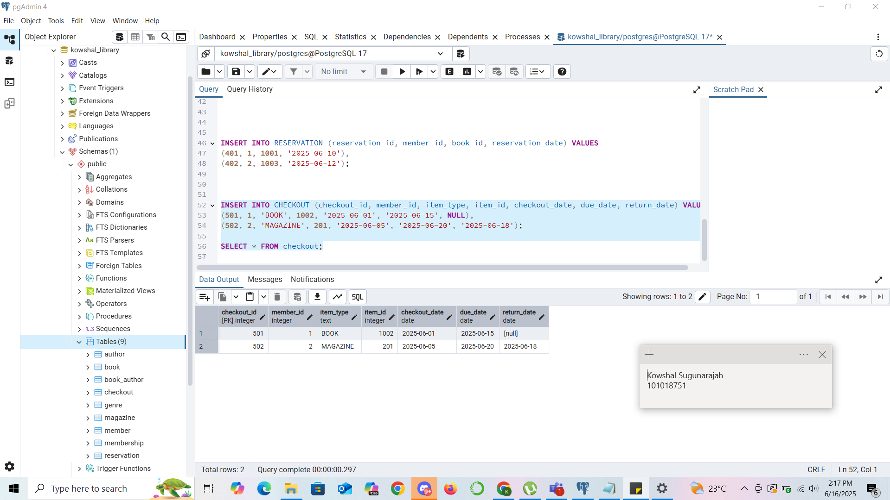
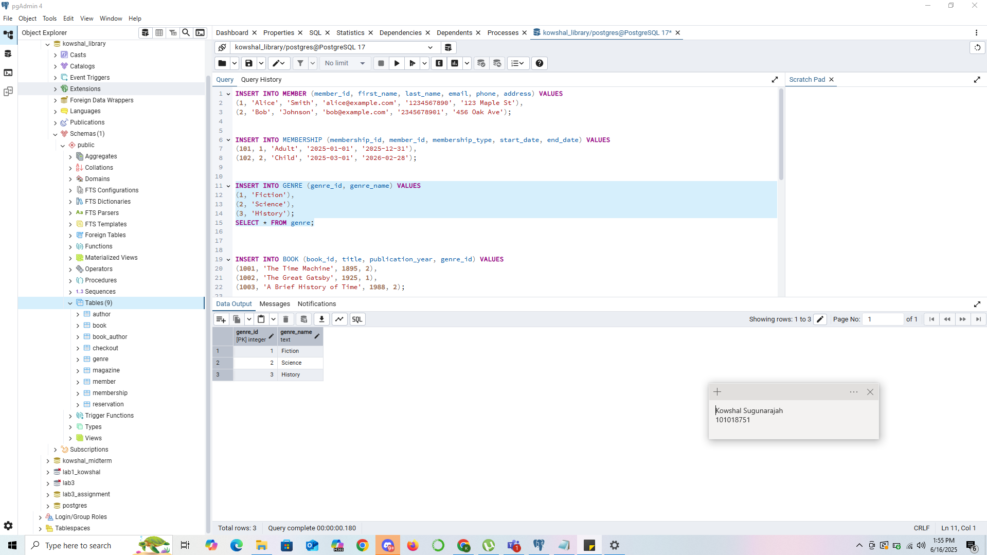
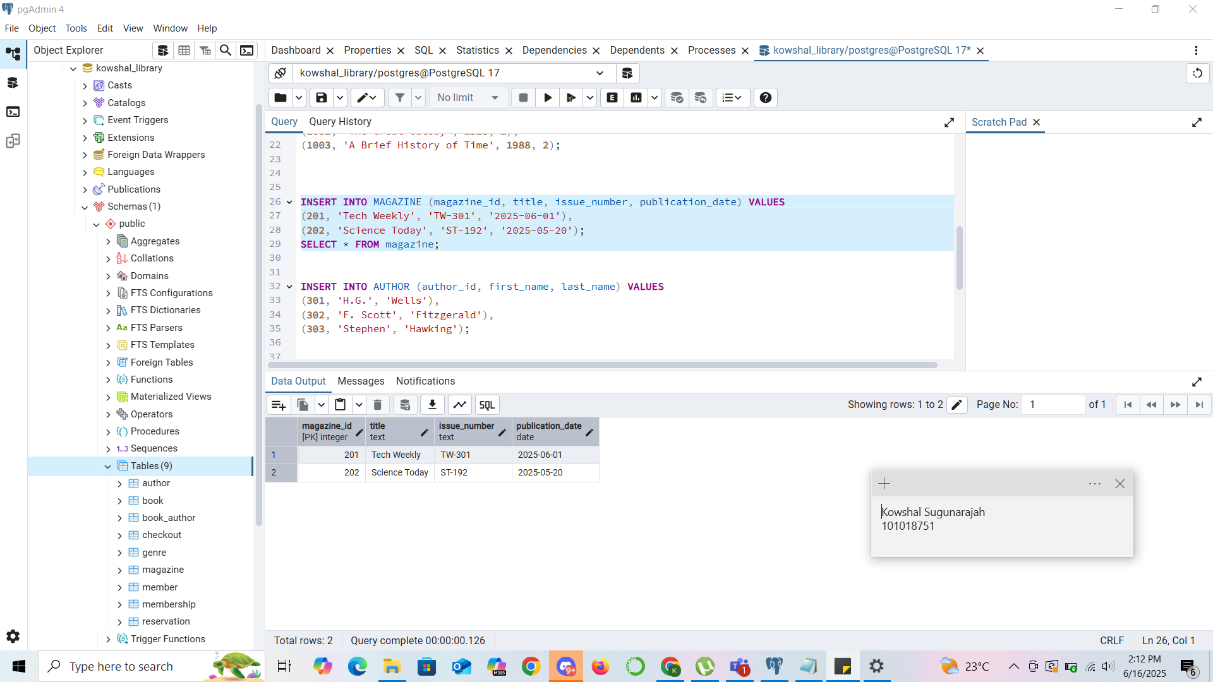
QUERY EXECUTION FOR INSERTING DATA

Slide 12
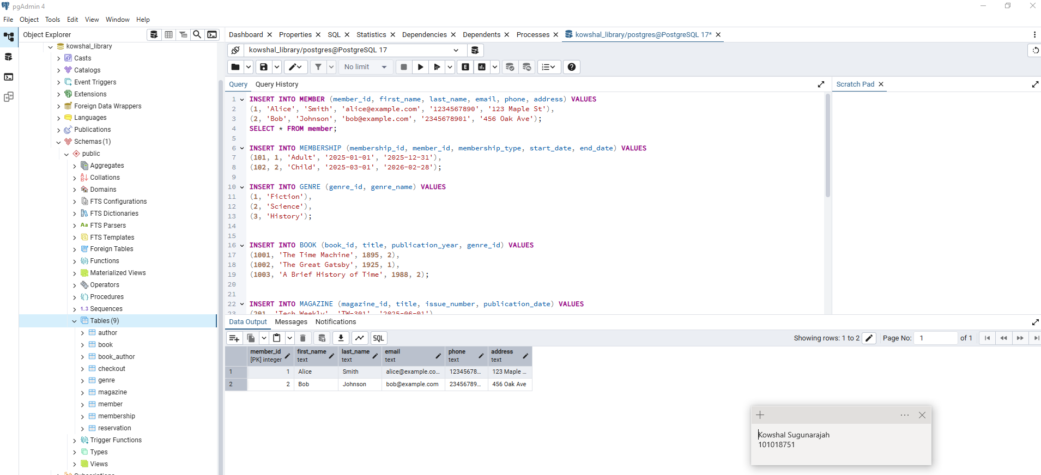
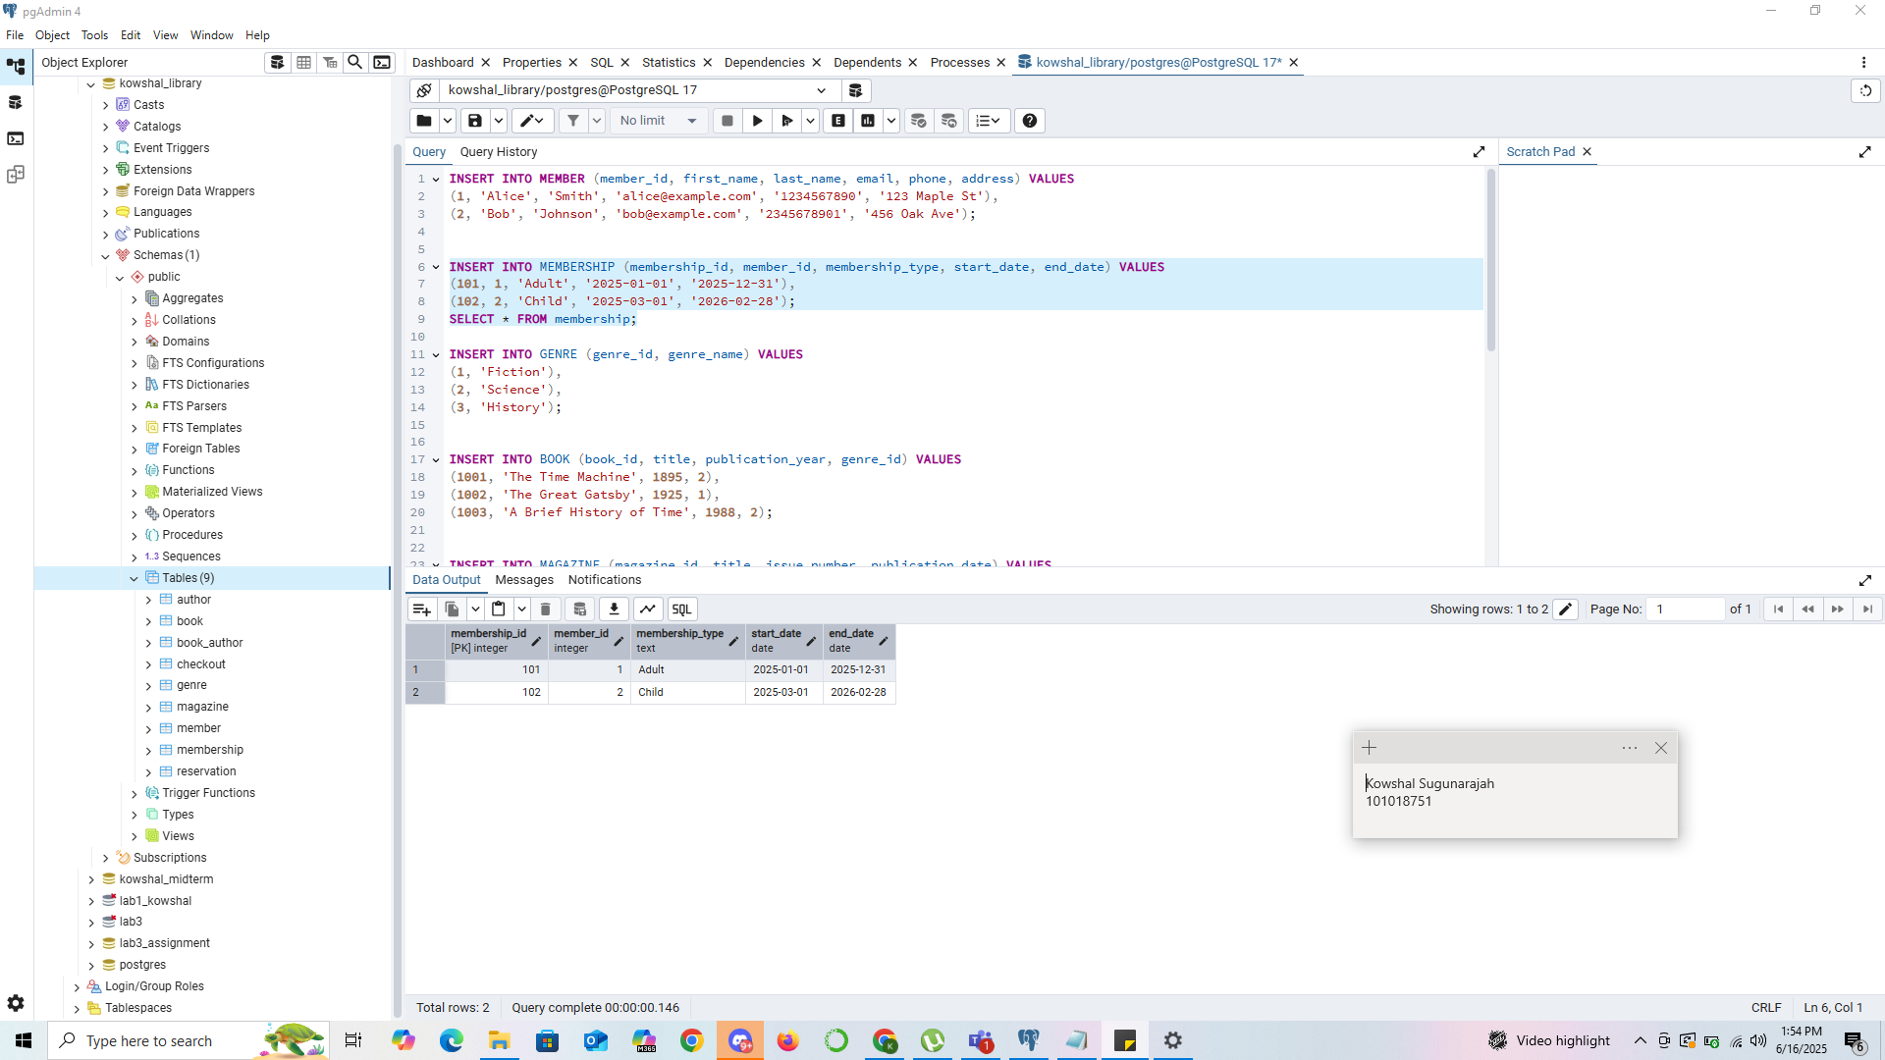
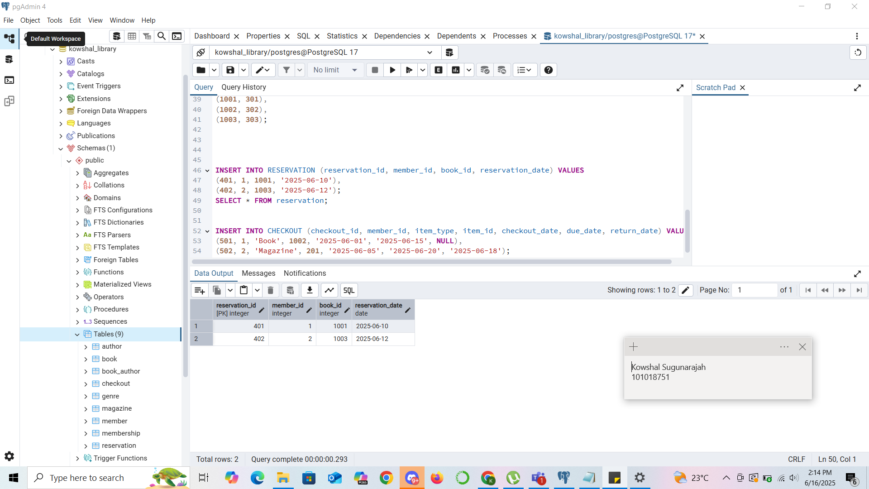
QUERY EXECUTION FOR INSERTING DATA

Slide 13
College Registration System – Business Definition Table
Entity | Definition | Relationships
Student | A person enrolled in college. | Enrolls in many Courses via Enrollment Majors/Minors in Departments
Course | An academic offering with possible prerequisites. | Belongs to one Department Taught by one Professor Has many Students via Enrollment Has multiple Prerequisites (self-relationship)
Professor | A person who teaches courses. | Teaches multiple Courses
Department | Academic unit offering courses. | Has many Courses Can be Major/Minor for many Students
Enrollment | Registration record of a student in a course. | Links one Student and one Course (Many-to-many relationship)
Prerequisite | Indicates a course must be taken before another. | Self-relation between two Courses (many-to-many)

Slide 14
RELATIONSHIPS
College Registration System
Key Concepts to Include:
Entities: Student, Course, Professor, Department, Enrollment, Prerequisite
Relationships:
Student–Enrollment (many-to-many)
Course–Professor (many-to-one)
Course–Department (many-to-one)
Course–Prerequisite (self-referencing many-to-many)
Student–Department (Major, Minor — many-to-one or many-to-many with roles)

Slide 15
ENTITY AND ATTRIBUTES
College Registration System
Entity | Attributes
Student | student_id (PK), first_name, last_name, email, major_department_id (FK), minor_department_id (FK)
Professor | professor_id (PK), first_name, last_name, email, department_id (FK)
Department | department_id (PK), department_name
Course | course_id (PK), course_name, credits, department_id (FK), professor_id (FK)
Prerequisite | course_id (FK), prerequisite_course_id (FK)
Enrollment | enrollment_id (PK), student_id (FK), course_id (FK), enrollment_date, grade

Slide 16
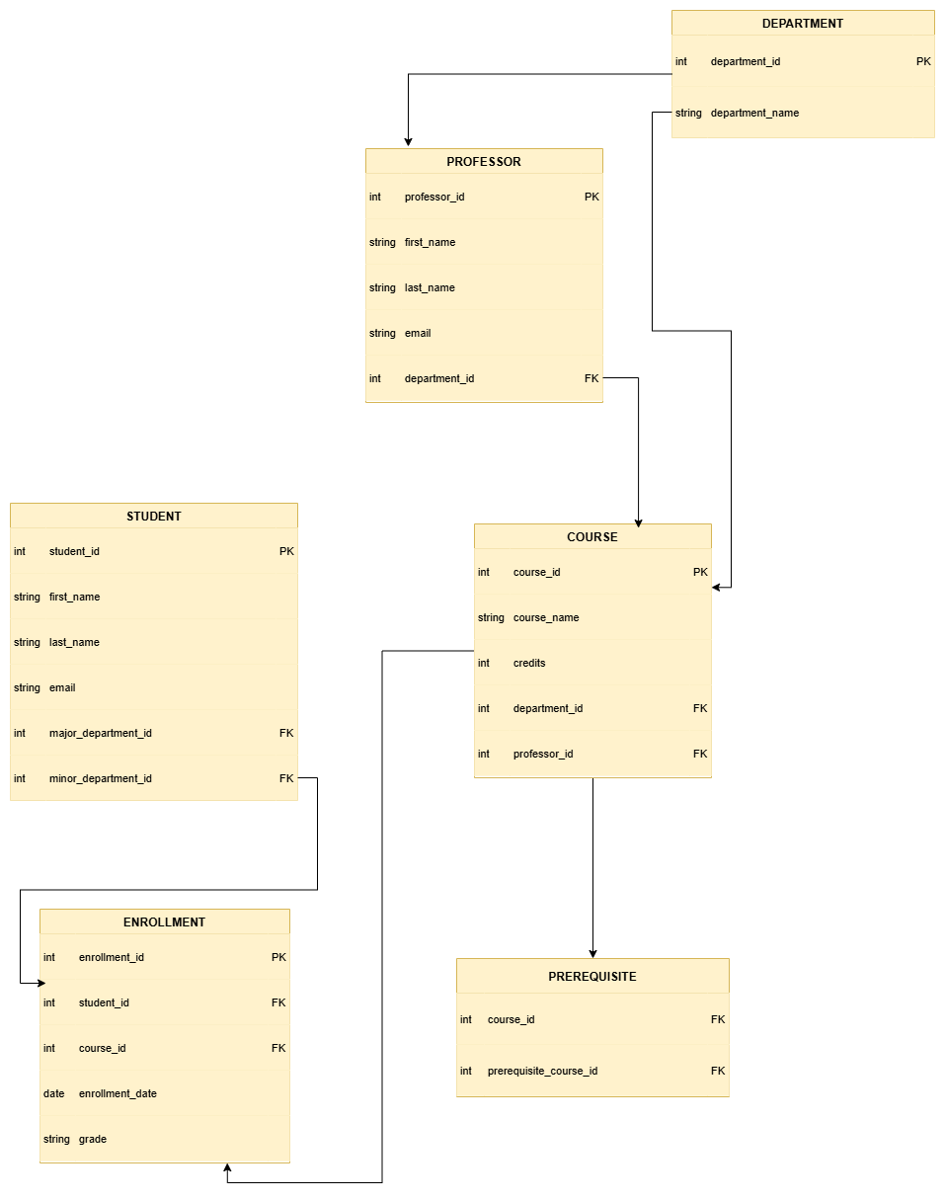
Logical model
College Registration System

Slide 17
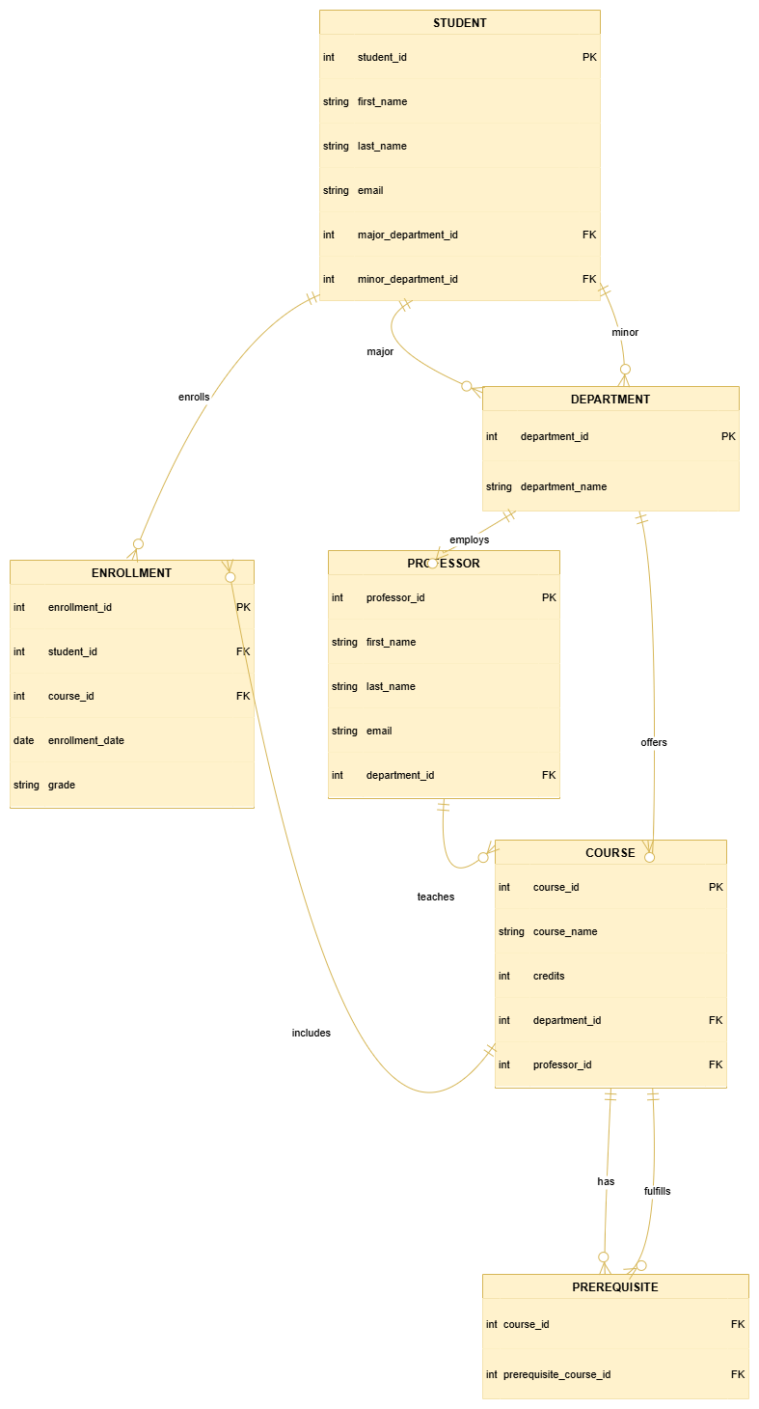
Entity-Relationship Model
College Registration System

Slide 18
PHYSICAL DESIGN
CREATING TABLES QUERIES
CREATE TABLE STUDENT ( student_id int PRIMARY KEY, first_name text, last_name text, email text, major_department_id int, minor_department_id int ); | CREATE TABLE PROFESSOR ( professor_id int PRIMARY KEY, first_name text, last_name text, email text, department_id int ); | CREATE TABLE DEPARTMENT ( department_id int PRIMARY KEY, department_name text );
CREATE TABLE COURSE ( course_id int PRIMARY KEY, course_name text, credits int, department_id int, professor_id int, FOREIGN KEY (department_id) REFERENCES DEPARTMENT(department_id), FOREIGN KEY (professor_id) REFERENCES PROFESSOR(professor_id) ); | CREATE TABLE PREREQUISITE ( course_id int, prerequisite_course_id int, PRIMARY KEY (course_id, prerequisite_course_id), FOREIGN KEY (course_id) REFERENCES COURSE(course_id), FOREIGN KEY (prerequisite_course_id) REFERENCES COURSE(course_id) ); | CREATE TABLE ENROLLMENT ( enrollment_id int PRIMARY KEY, student_id int, course_id int, enrollment_date date, grade text, FOREIGN KEY (student_id) REFERENCES STUDENT(student_id), FOREIGN KEY (course_id) REFERENCES COURSE(course_id) );

Slide 19
PHYSICAL DESIGN
INSERTING DATA QUERIES
INSERT INTO STUDENT (student_id, first_name, last_name, email, major_department_id, minor_department_id) VALUES (1, 'John', 'Doe', 'john.doe@example.edu', 10, 20), (2, 'Jane', 'Lee', 'jane.lee@example.edu', 20, NULL); | INSERT INTO PROFESSOR (professor_id, first_name, last_name, email, department_id) VALUES (101, 'Alan', 'Turing', 'alan.turing@college.edu', 10), (102, 'Marie', 'Curie', 'marie.curie@college.edu', 20); | INSERT INTO DEPARTMENT (department_id, department_name) VALUES (10, 'Computer Science'), (20, 'Physics'), (30, 'Mathematics');
INSERT INTO COURSE (course_id, course_name, credits, department_id, professor_id) VALUES (1001, 'Intro to Programming', 3, 10, 101), (1002, 'Data Structures', 3, 10, 101), (2001, 'Modern Physics', 4, 20, 102); | INSERT INTO PREREQUISITE (course_id, prerequisite_course_id) VALUES (1002, 1001); | INSERT INTO ENROLLMENT (enrollment_id, student_id, course_id, enrollment_date, grade) VALUES (5001, 1, 1001, '2025-01-10', 'A'), (5002, 1, 1002, '2025-03-15', 'B+'), (5003, 2, 2001, '2025-02-01', 'A-');

Slide 20
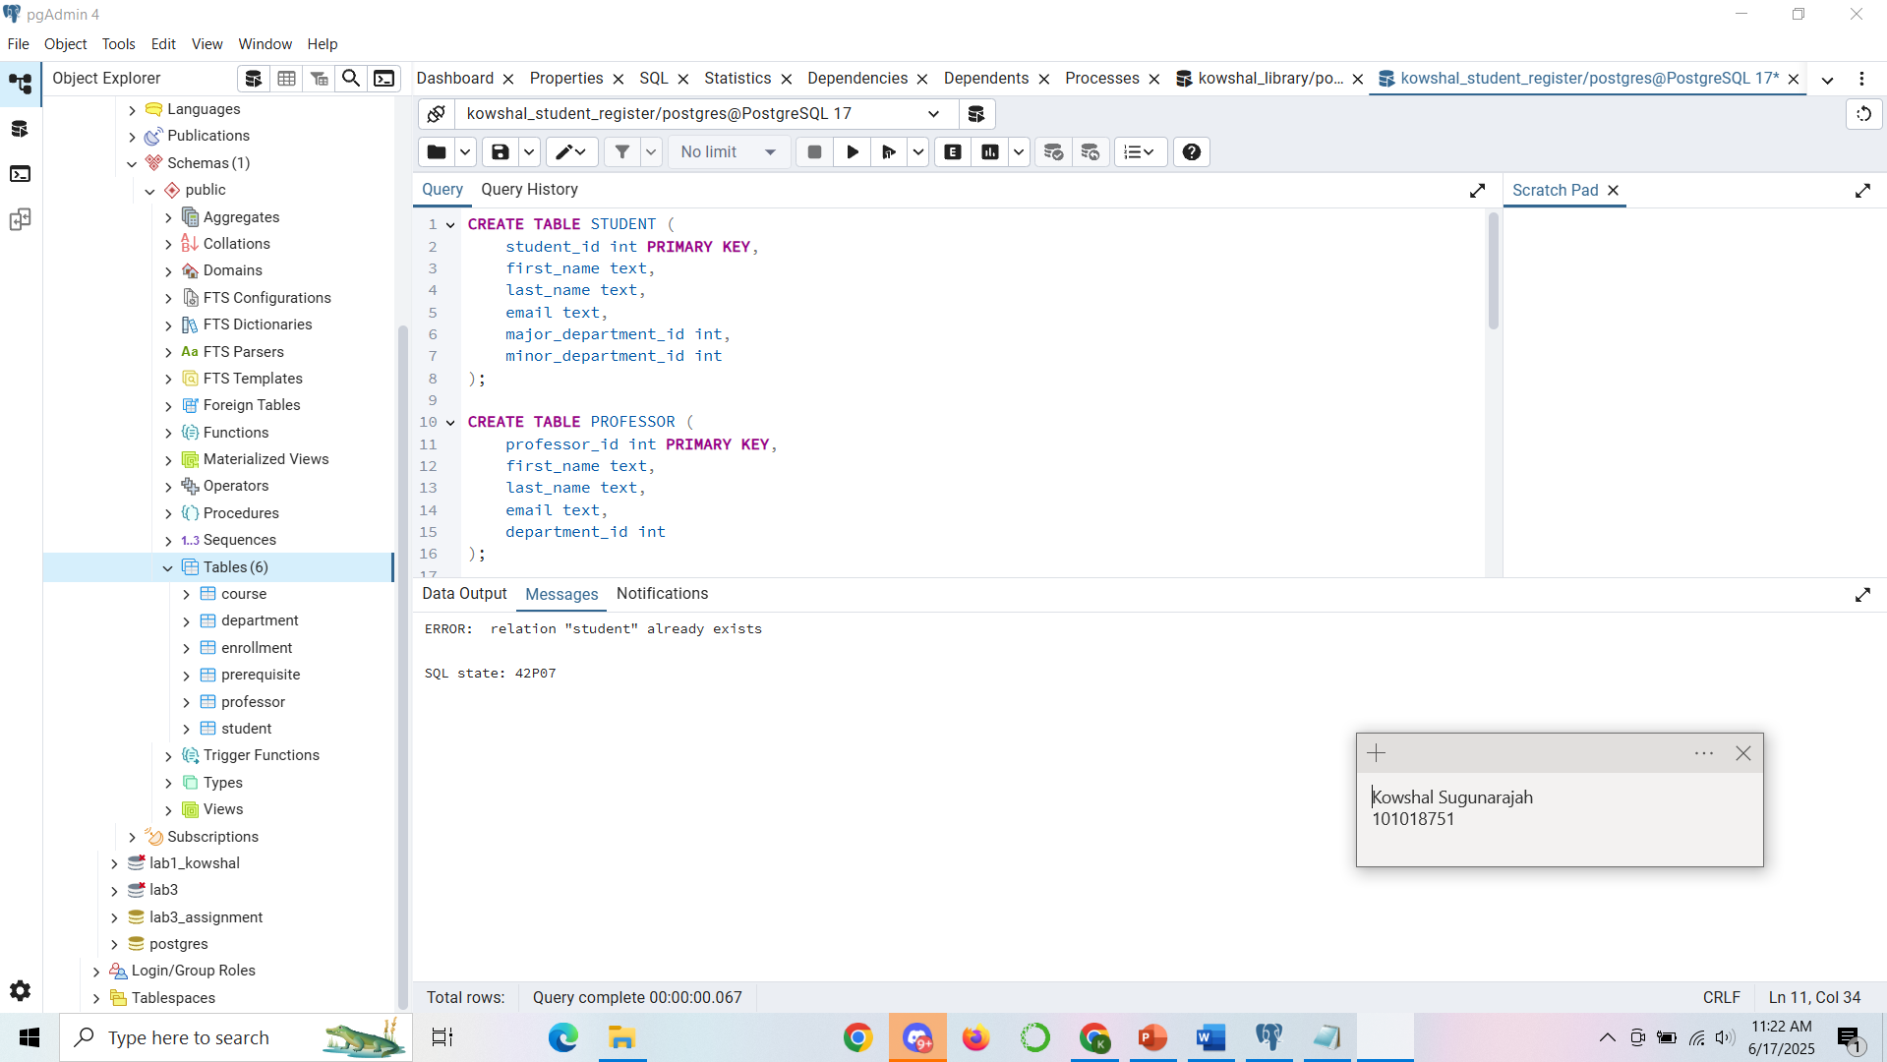
QUERY EXECUTION FOR creating tables

Slide 21
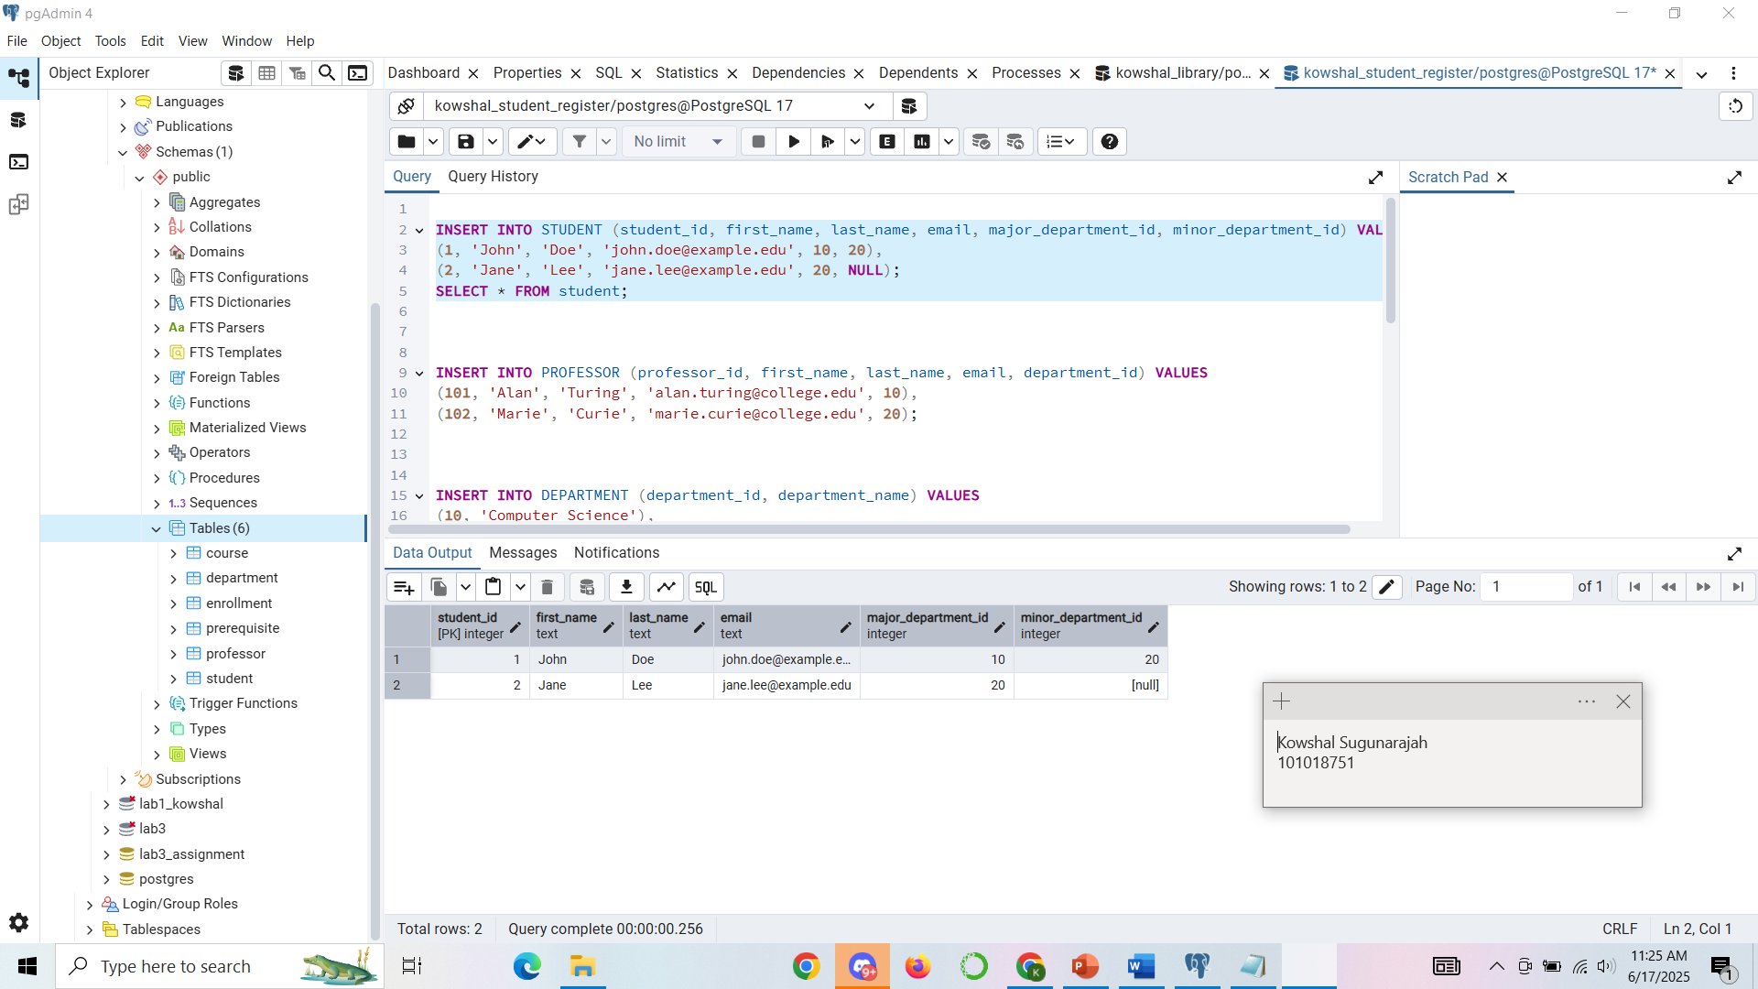
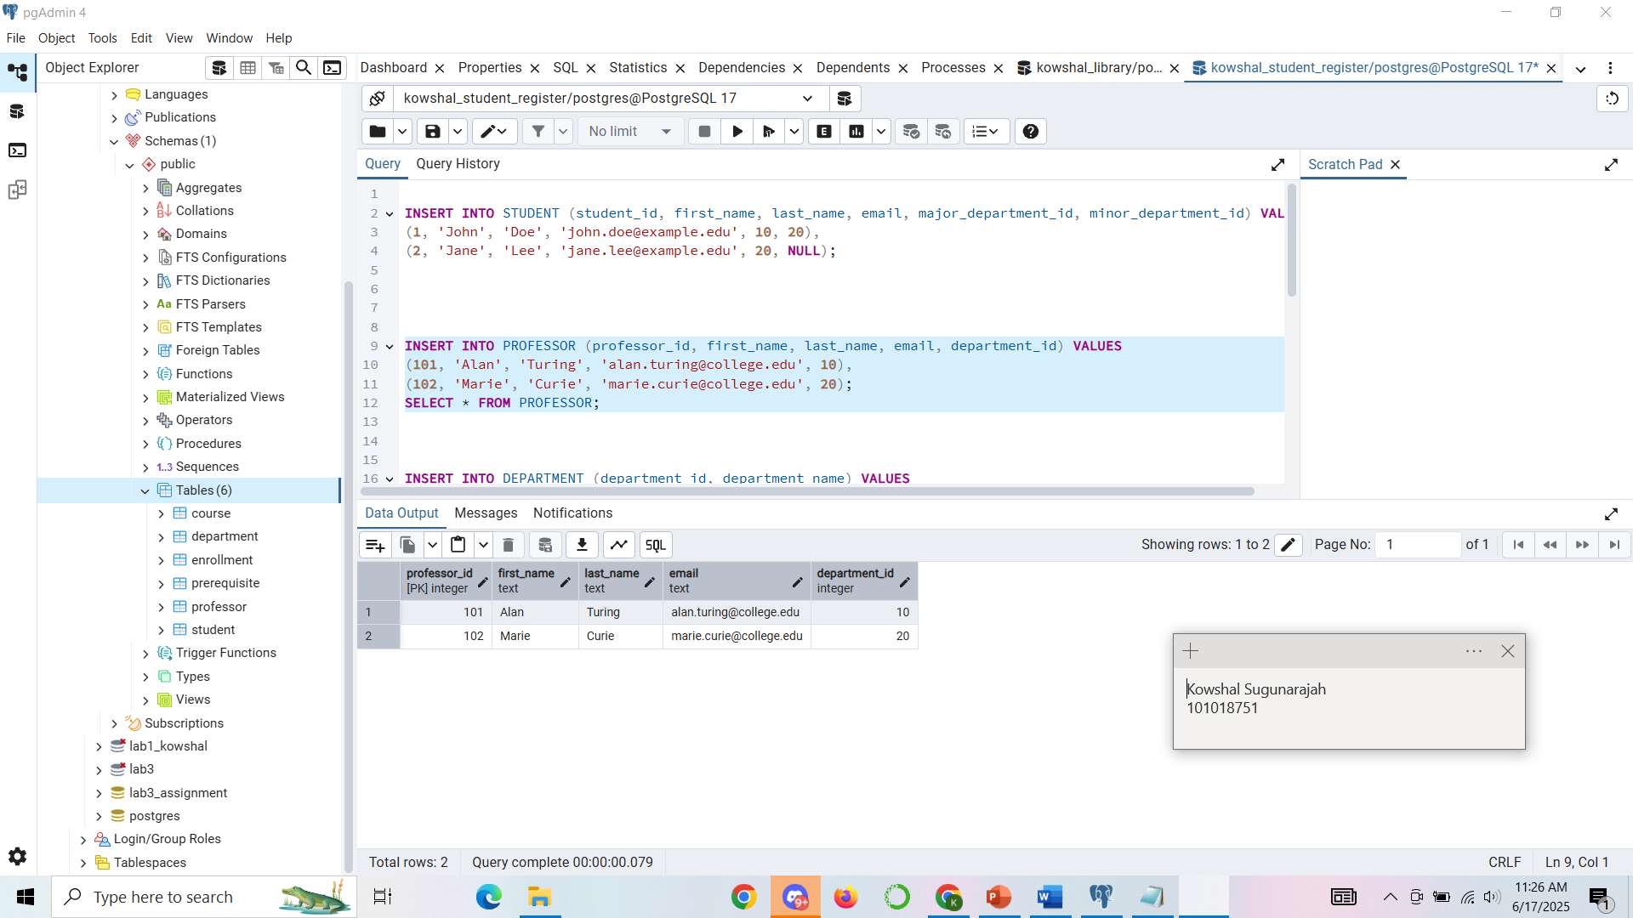
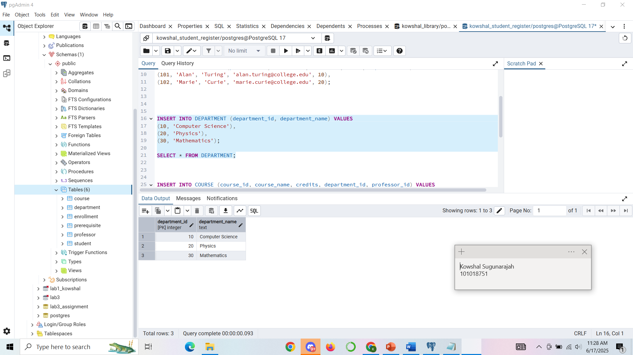
QUERY EXECUTION FOR INSERTING DATA

Slide 22
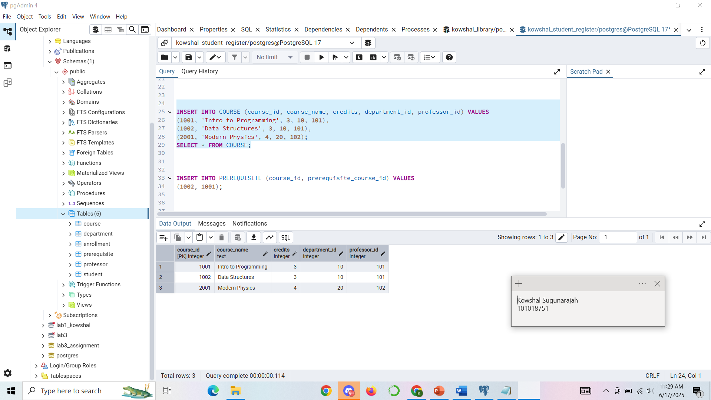
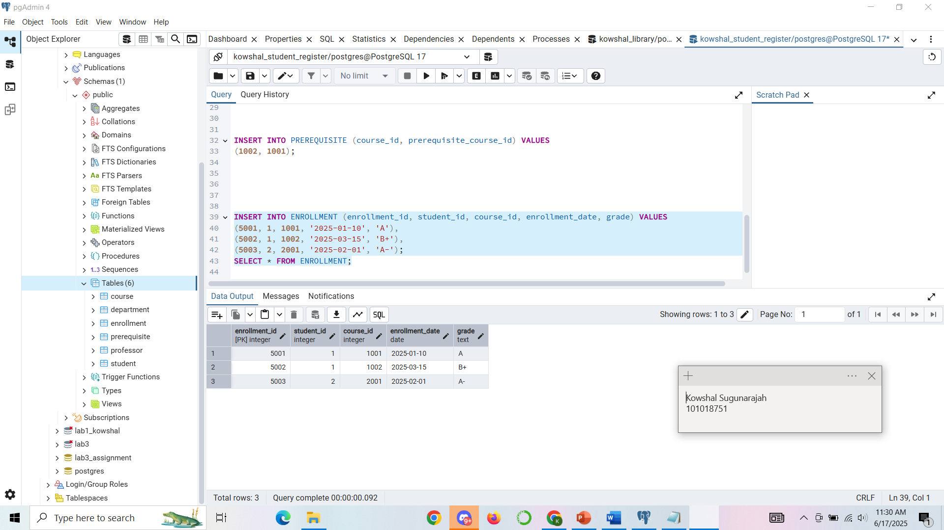
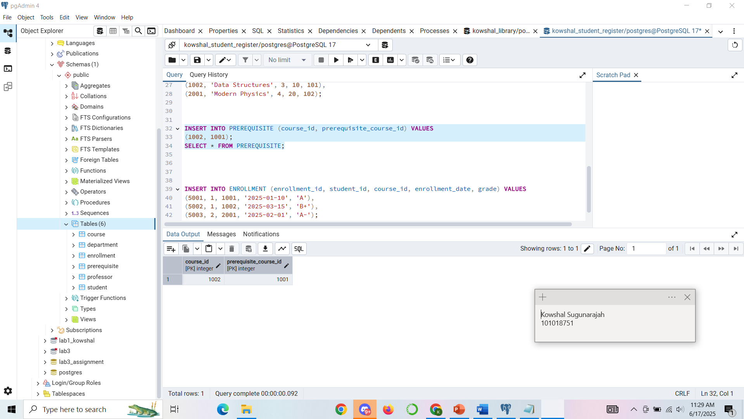
QUERY EXECUTION FOR INSERTING DATA

Slide 23
Thank you

